Slide 1

AMIT LEARNING
BRAIN
CANCER
An AI-based brain tumor classification system that analyzes MRI images to automatically distinguish between different tumor types and healthy brains, supporting faster and more accurate medical diagnosis.

Slide 2

1
Introduction
2
Analysis
4
Preprocessing
AGENDA
5
Models
6
Evaluation
7
Deployment
8
Conclusion

Slide 3

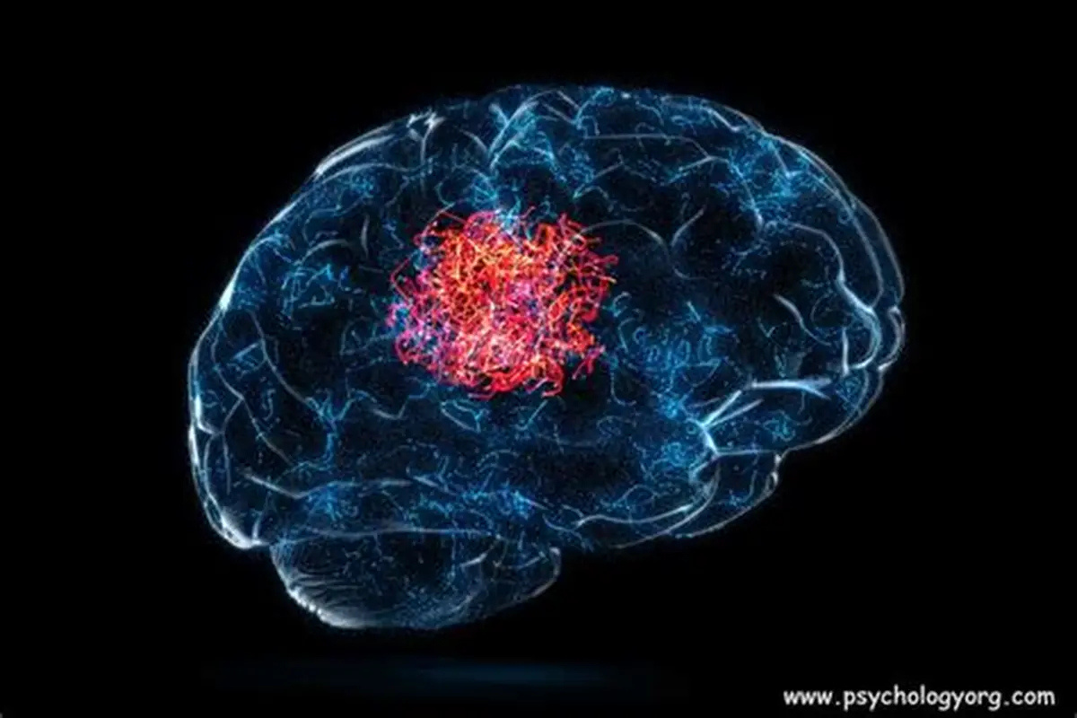
INTRODUCTION
Brain tumors are among the most serious and life-threatening neurological conditions, where accurate and early diagnosis plays a crucial role in determining appropriate treatment strategies and improving patient survival rates. Magnetic Resonance Imaging (MRI) is widely used for brain examination due to its high-resolution visualization of soft tissues and its ability to reveal structural abnormalities without invasive procedures.
Despite its effectiveness, the interpretation of brain MRI scans remains a challenging and time-consuming task that relies heavily on the expertise of radiologists. Variations in tumor appearance, location, size, and intensity can lead to diagnostic uncertainty, especially in complex or early-stage cases. As medical imaging data continues to grow rapidly, there is an increasing need for automated and reliable diagnostic support systems.
This project explores the use of artificial intelligence to assist in the classification of brain tumors from MRI images. By learning patterns directly from imaging data, the proposed system aims to distinguish between different types of brain tumors as well as healthy brain scans. Such an automated approach has the potential to support medical professionals by improving diagnostic consistency, reducing workload, and providing faster preliminary assessments.

Slide 4

OBSERVING DATA
DATA COLUMNS
DATA OVERVIEW
DATA AUGMENTATION

Slide 5

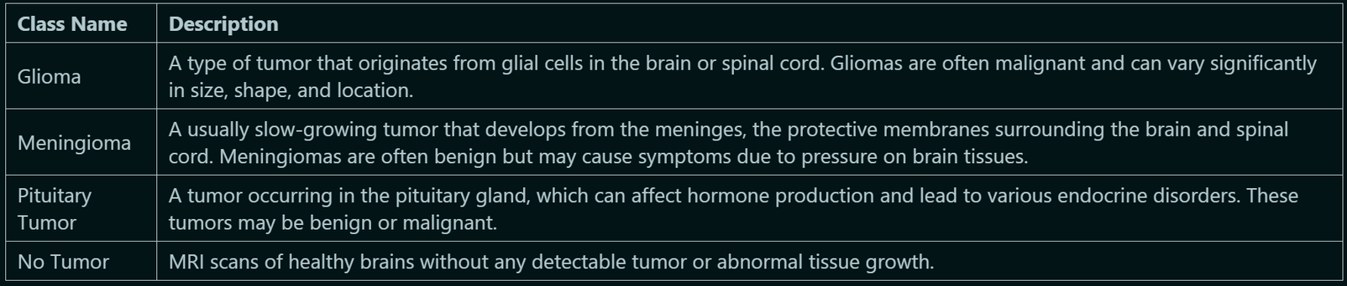
DATA
COLUMNS

Slide 6
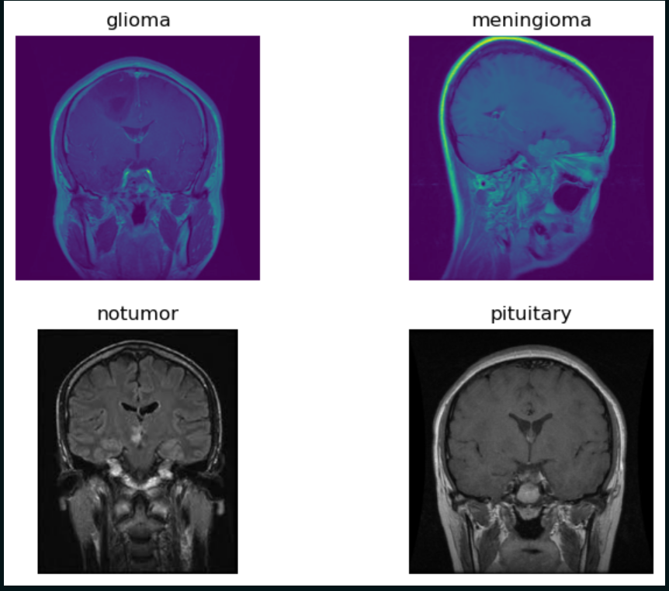
DATA OVERVIEW

Slide 7

DATA READING & AUGMENTATION
TRAINING DATA: FIRST I USED PREPROCESS INPUT FUNCTION THAT IS SUITABLE WITH PRETRAINED MODEL THAT I USED , AND WITH SOME AUGMENTATION
VALIDATION, TEST DATA: I MADE SAME PREPROCESSING FOR THIS SUBSETS

Slide 8
DATA ANALYSIS
CLASSES COUNT
CLAHE EFFECT
PIXEL INTENSITIES

Slide 9
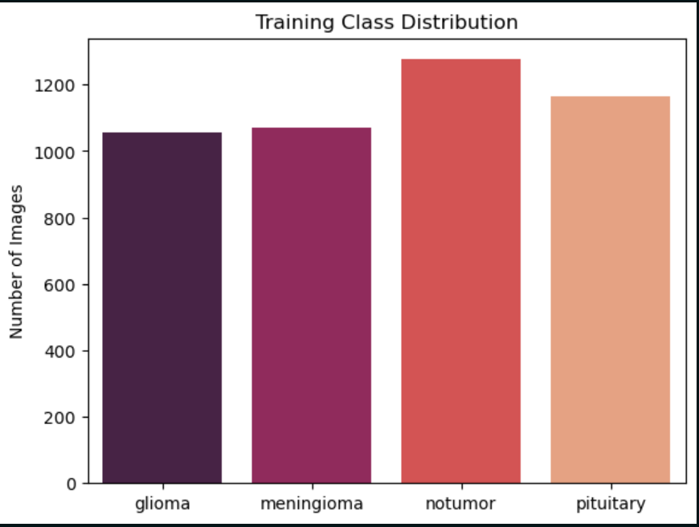
CLASSES COUNT

Slide 10
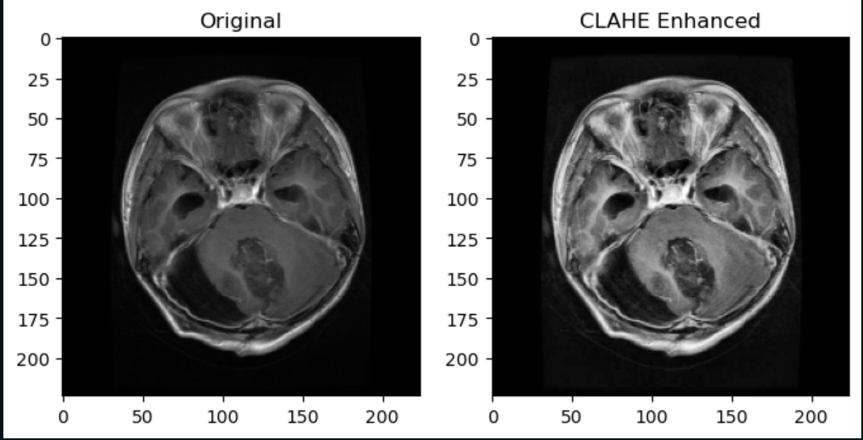
CLAHE
EFFECT

Slide 11
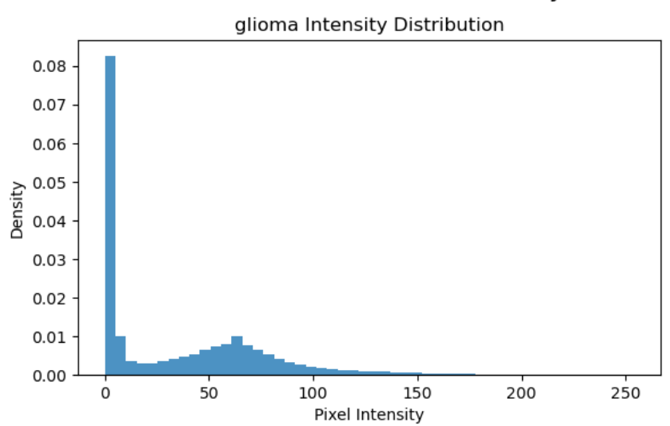
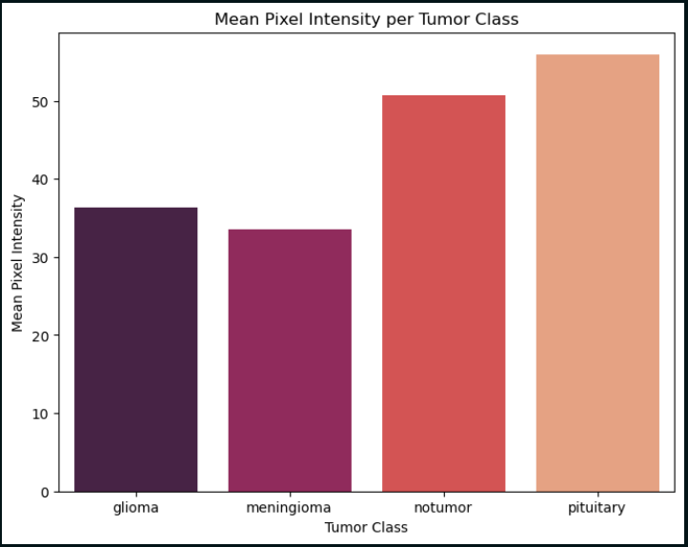
PIXEL INTENSITIES

Slide 12
MODEL TRAINING
MODELS TRIED
EVALUATION

Slide 13
DENSENET
DENSE CONNECTIONS IMPROVE FEATURE REUSE AND GRADIENT FLOW
EFFECTIVE FOR CAPTURING SUBTLE MEDICAL IMAGE TEXTURES
RESNET
RESIDUAL CONNECTIONS ENABLE DEEPER NETWORKS
STRONG PERFORMANCE AND TRAINING STABILITY
EFFICIENTNET (FINAL MODEL)
USES COMPOUND SCALING OF DEPTH, WIDTH, AND RESOLUTION
ACHIEVES HIGH ACCURACY WITH FEWER PARAMETERS
PARTICULARLY SUITABLE FOR MEDICAL IMAGING WITH LIMITED DATA
EFFICIENTNET DEMONSTRATED THE BEST BALANCE BETWEEN ACCURACY, EFFICIENCY, AND GENERALIZATION

Slide 14
FINE TUNING & TRAINING CONFIGURATION
Initial layers of each pretrained model were frozen to preserve generic visual features
Higher layers were gradually unfrozen to adapt to MRI-specific patterns
A custom classification head was added:
Global Average Pooling
Dense layer with ReLU activation
Dropout for regularization
Softmax layer for multi-class classification
Optimizer: Adam with a low learning rate for stable fine-tuning
Loss function: Categorical Cross-Entropy
Early stopping based on validation loss
Training continued until convergence

Slide 15
EVALUATION

Slide 16
MODEL EVALUATION
PERFORMANCE WAS EVALUATED USING
ACCURACY
PRECISION, RECALL, AND F1-SCORE
CONFUSION MATRIX
MULTI-CLASS ROC–AUC CURVES
BASED ON COMPARATIVE EXPERIMENTS
EfficiENTNET OUTPERFORMED DENSENET AND RESNET
PROVIDED BETTER GENERALIZATION ON UNSEEN MRI SCANS
REQUIRED FEWER PARAMETERS WHILE MAINTAINING HIGH PERFORMANCE

Slide 17
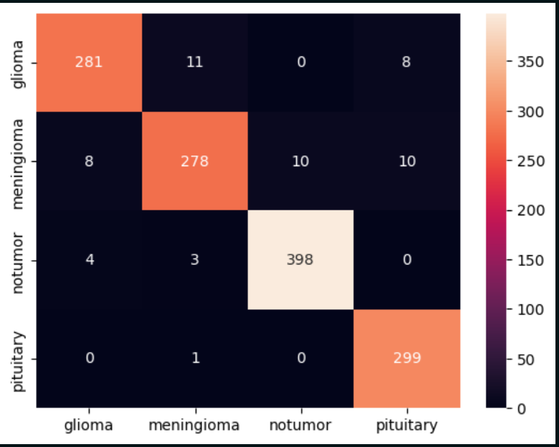
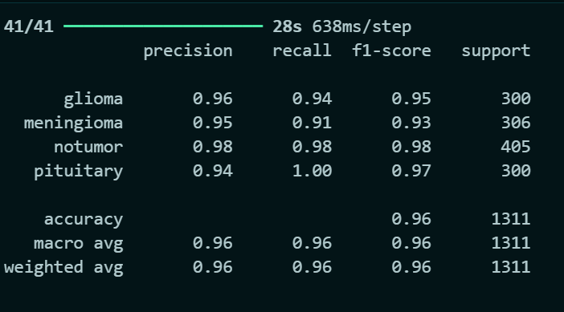
Confusion Matric & Classification Report
(CatBoost)

Slide 18
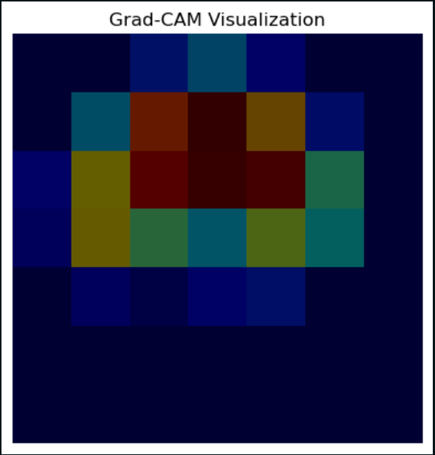
GRAD_CAM

Slide 19

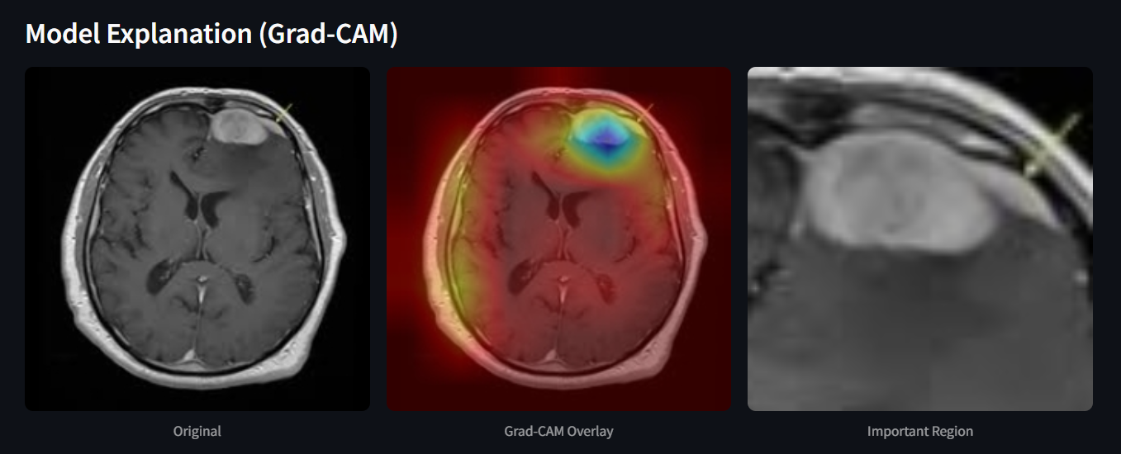
ORIGINAL IMAGE & GRAD_CAM & ZOOMED REGION

Slide 20
DEPLOYMENT

Slide 21
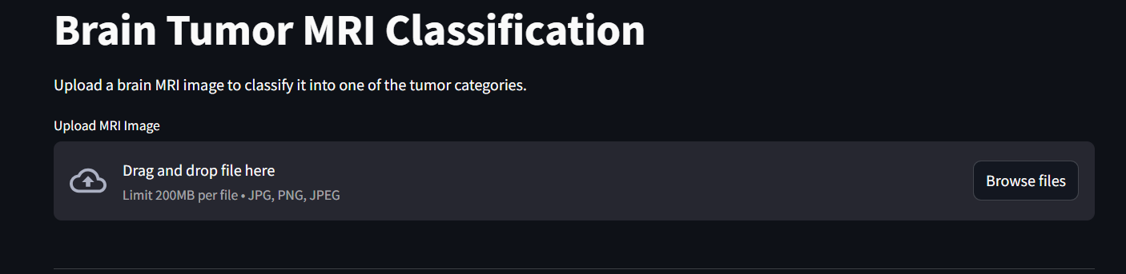

Slide 22
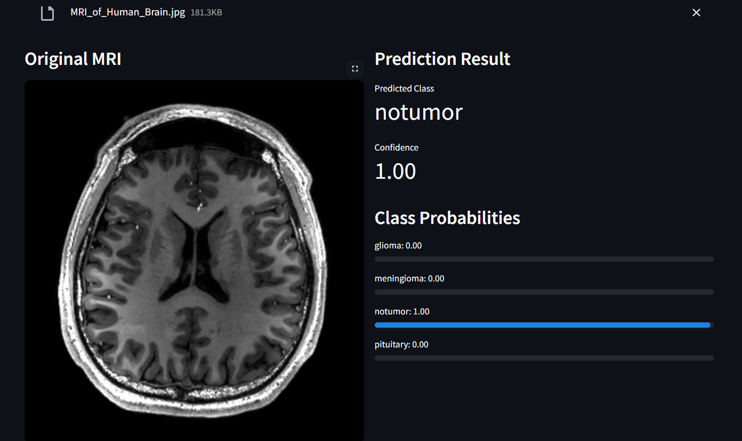

Slide 23
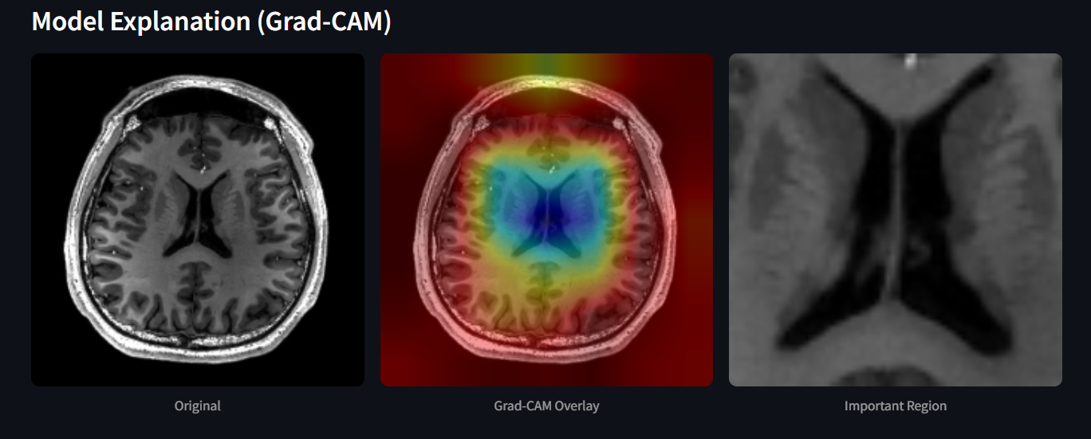

Slide 24
LIBRARIES USED
os
1
Numpy
2
Matplotlib & Seaborn
3
cv2
4
Sklearn & tensorflow
5
PIL
6

Slide 25
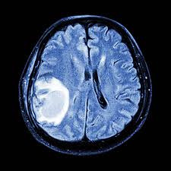
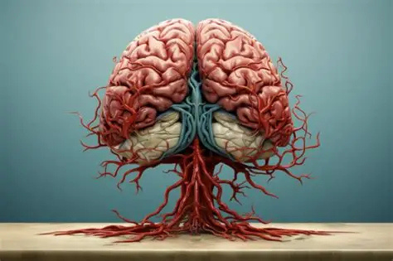
CONCLUSION
An end-to-end deep learning approach was developed for brain tumor classification from MRI images. Through effective preprocessing, data augmentation, and transfer learning, EfficientNet achieved strong and reliable performance across all tumor classes. Additional analysis and visualization techniques enhanced model interpretability, demonstrating the system’s potential as a practical and supportive tool for medical image analysis.

Slide 26

THANK YOU
MOHAMED TAREK EL-ERAKY

